Slide 1

AISC1006 – Group B
Fraud Detection
Deep Diving into Data

Slide 2

Agenda
Recap
Gantt Progress
Pipeline and Functions
Exploring Correlation
Multicollinearity Check
Imbalance Check
SMOTE, ADASYN, NearMiss
Midbalancing proposal
Next Steps
Our today’s agenda is focused on Exploring the data and some techniques we used in our project so far.

Slide 3
Our plan for the last few weeks
Goals
Have a better understanding of how to deal with imbalance and explore some techniques;
Analyze linear correlation between variables;
Understand and apply techniques to fill missing values and wrong column types;
Start to work with functions to create a Pipeline.
Progress: 100% done

Slide 4

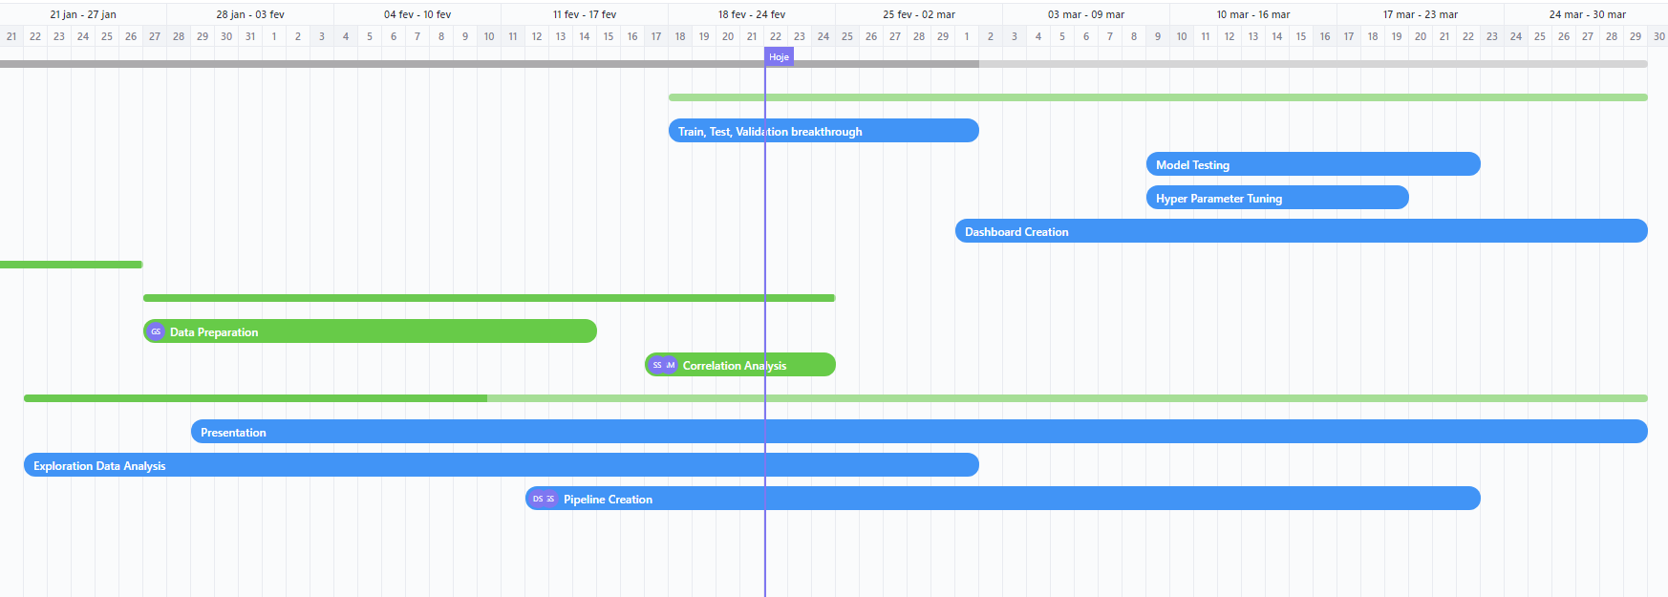
Gantt Progress

Slide 5
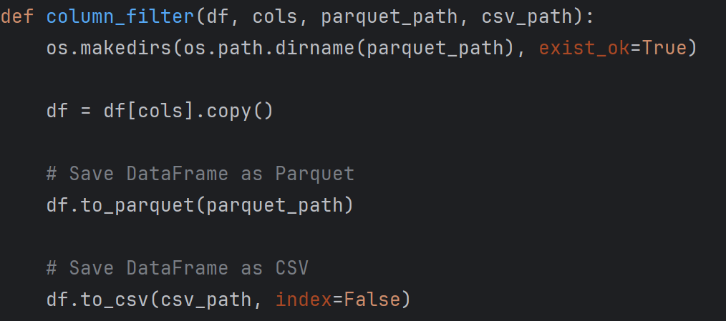
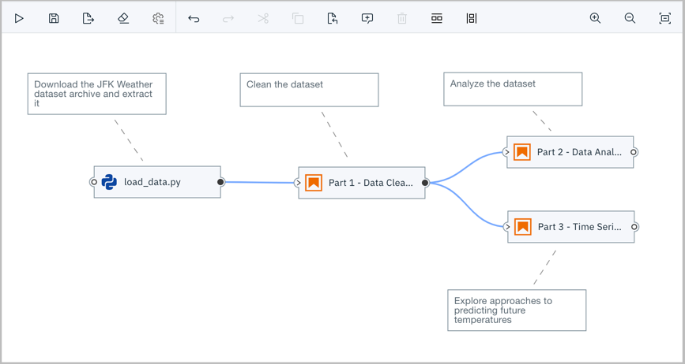
Pipelines and Functions
What’s that magic? What they eat? How they breath??
The first question is what are functions and pipelines?
How do we put it all together?
What is the sorcery on those images?
Accessed on IBM Developer, 02/22/2024

Slide 6

Let’s talk about Data

Slide 7
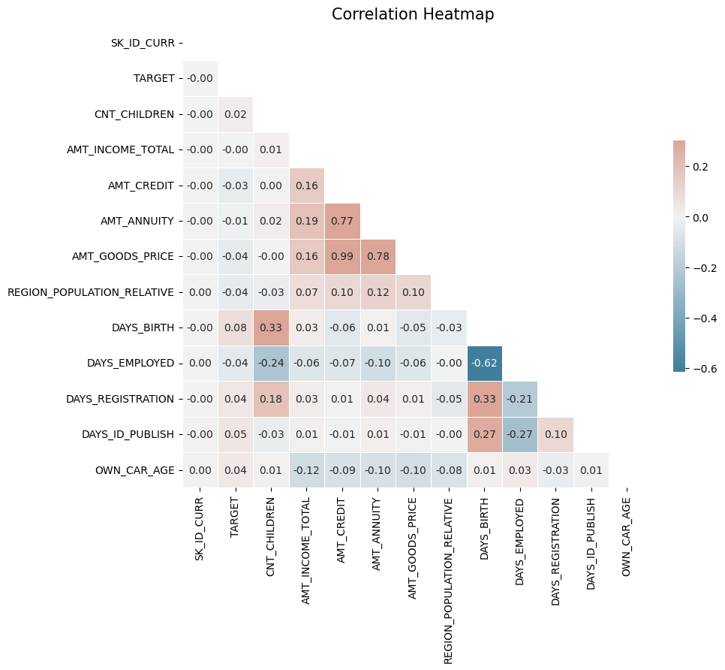
Correlation Deep Dive
We have a few variables that are highly linear correlated such:
Ammount of Annuity x Credit
Goods Price x Credit
Goods Price x Annuity
Days Employed x Days birth
Let’s explore a few of these linear correlation a bit more.

Slide 8
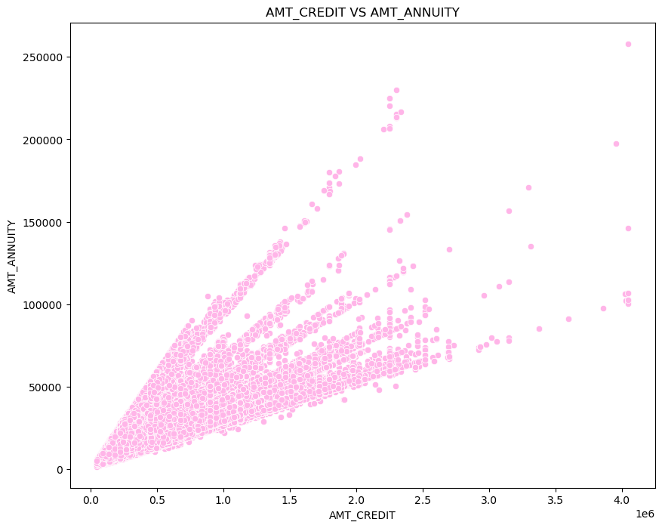
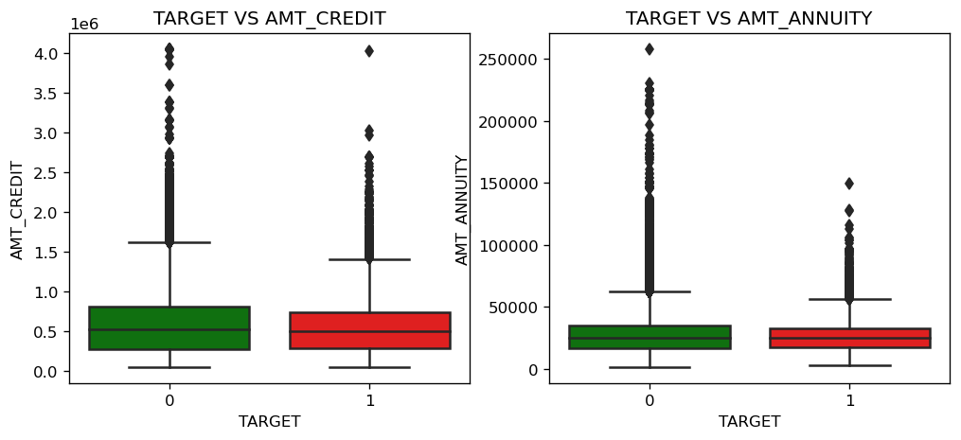
Credit x Annuity
There is a high correlation, but we have a few distinct outliers here and since we have a high correlation of annuity x goods price it’s a good idea to deep dive into credit x goods price which are distinct to decide.

Slide 9
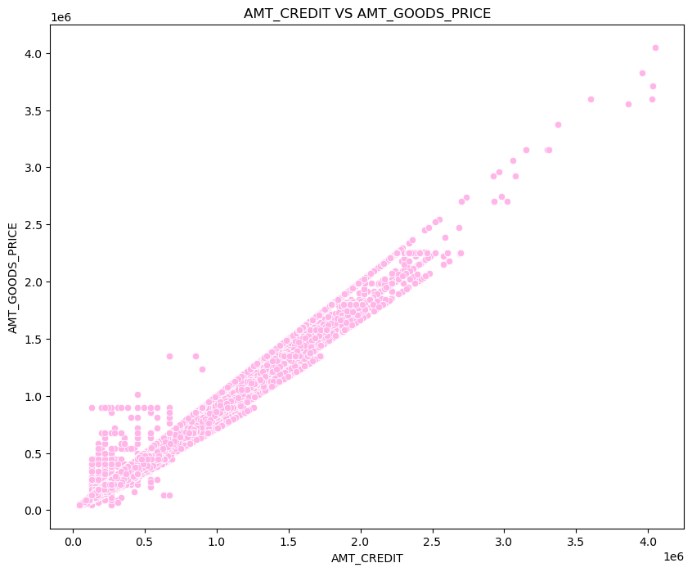
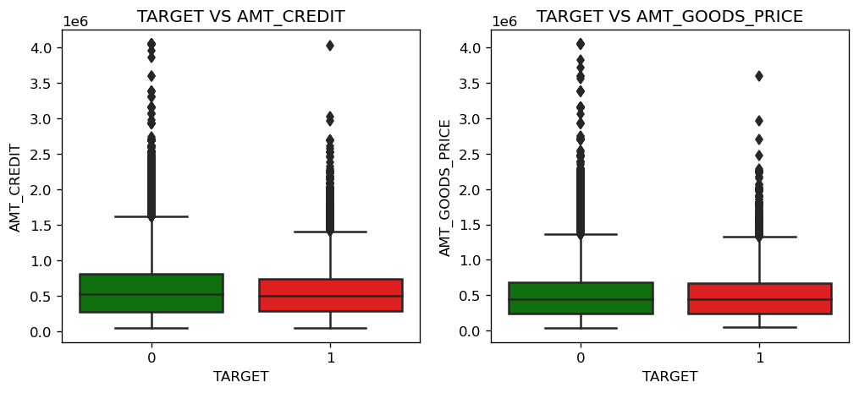
Credit x Goods Price
This is our highest correlation so far, amounting to 0.99! So our idea here is to delete goods price since it has a high correlation with Annuity as well.

Slide 10
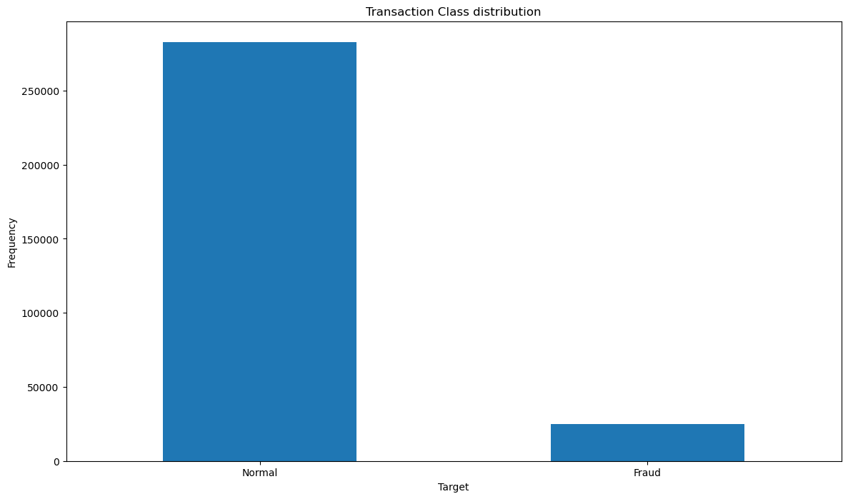
Imbalance
What is imbalance?
You see how big is the difference of fraud x no fraud?
That’s what we want to tackle!

Slide 11
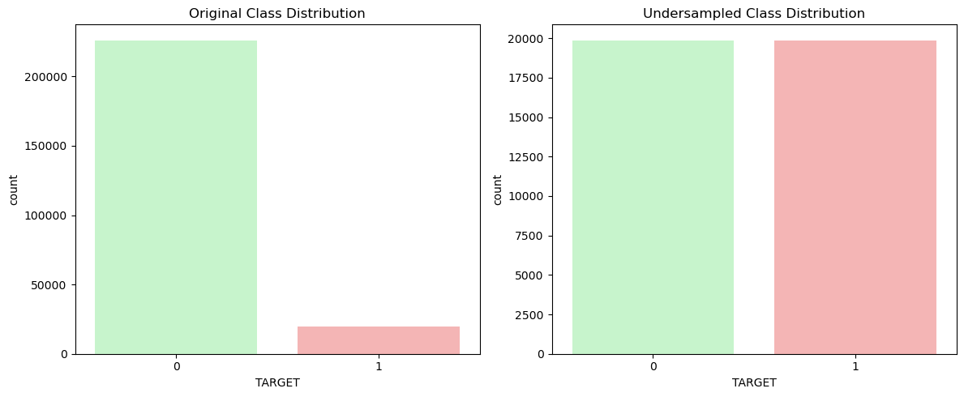

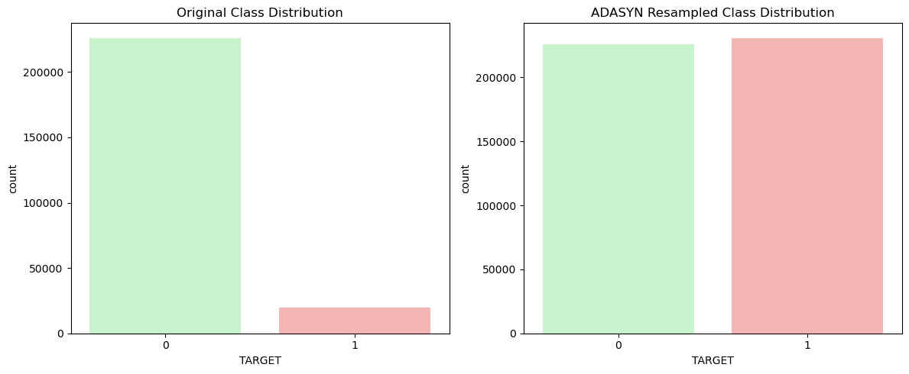
Imbalance Techniques
Undersample
Oversample
NearMiss
SMOTE
ADASYN

Slide 12
Balancing Proposal
Let’s mix Oversampling with Undersampling.
This will give us something called midsampling.
How?
ADASYN
NearMiss
+

Slide 13
Next Steps
Goals
Train, test validation steps;
More pipelines;
Start the concepts of Dashboard
Models, models and more models!!

Slide 14





Thanks!
We don’t charge for questions!! ☺

